Slide 1
DAT Class 7
Horizontal, Directional Data Extraction

Slide 2
Numpy & Pandas: An Introduction
Overview
Give students a brief but coherent overview of Numpy & Pandas, plus the role they serve in the python ecosystem
Important Note
Be prepared to handle issues with installation here.
Learning Objectives
In this lesson, students will:
Get their Jupyter notebook up and running
Introduce students to IPython computing environment
Introduce students to numpy arrays & pandas dataframes
Duration
45 min - 1 hour

Slide 3
Suggested Agenda
Time | Activity | Purpose
0:00 - 0:15 | Anaconda Download + Installation | Getting everyone’s install correct, introduction to Jupyter notebook
0:16 - 0:30 | Numpy Introduction | Discuss students the important details of what makes numpy unique, its role in data science ecosystem
0:31 - 0:45 | Pandas Introduction | What it does, how it interacts with numpy, what dataframes are.
0:46 - 0:50 | Summary | Finish this portion of the lesson by having students

Slide 4
Materials and Preparation
Time spent on this lesson might be highly variable depending on how difficult a time people have with getting their operating environment up and running.
Besides getting everyone’s Jupyter Notebook up and running, focus on making sure everyone has a broad conception about what makes numpy & pandas unique, and how they interact with one another
Wrap this lesson up by using pd.read_csv() to load in a dataframe

Slide 5
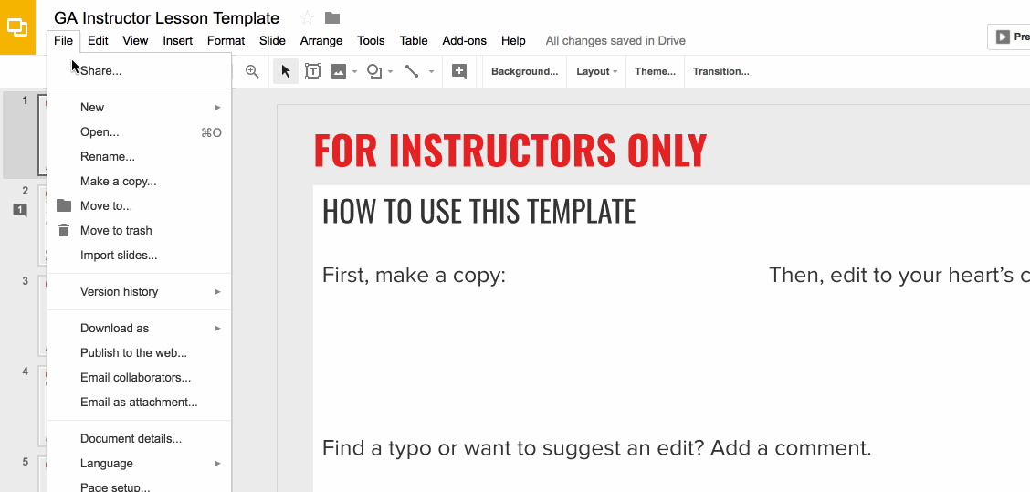
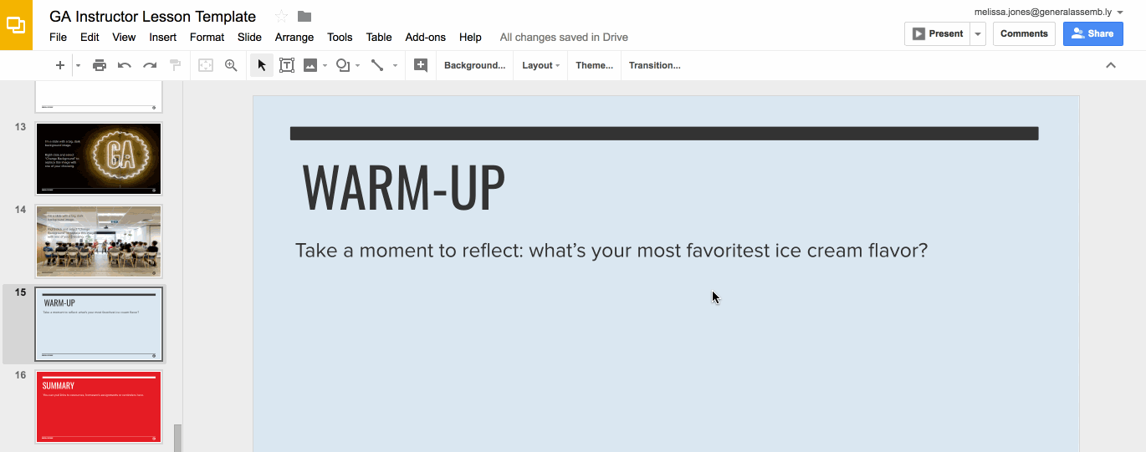
Preparation (Continued)
Ready to customize this lesson?
First things first, make a copy of this presentation. You’ll then be able to edit to your 💗’s content.
Find a typo or want to suggest an edit?
Add a comment. Our Product Advisory Board will review and incorporate your suggestions.

Slide 6
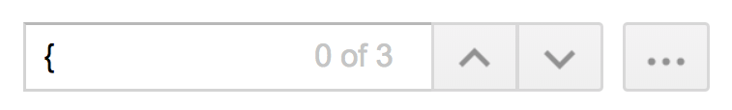
Preparation (Continued)
Remember to press Command F and do a search for instances of brackets in the deck. All instances of brackets denote places where instructors must fill in information/customize prior to presenting in class.

Slide 7
Differentiation and Extensions
This is a suggestion for a way in which instructors might change up this lesson to meet the needs of more advanced or less advanced students.
This is another suggestion.
This is another suggestion.
Be sure to link to any supplemental/optional materials on this slide.

Slide 8
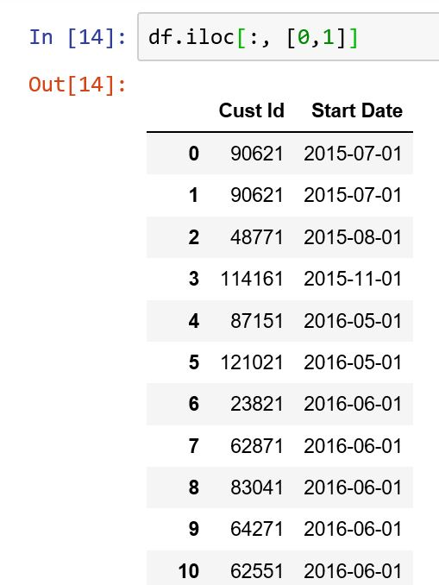
Pandas & Time
Extracting data from a date can be roughly be categorized in three different ways:
Grouped data extraction - summary statistics over particular months, years, etc.
Horizontal data extraction - looking at internal attributes of a particular date -- day of week, business day, etc.
Directional data extraction - rolling averages, momentum, etc
Notes:
3-5 MINUTES
TALKING POINTS
Go back into Jupyter notebook, and demonstrate how these commands work:
Try going over the following:
Grabbing one and multiple columns using labels
Column and row notation
Using both the .loc and .iloc commands, and their various manifestations.

Slide 9
Horizontal Data Extraction
Looking at internal characteristics of a date:
Is it a holiday? End of the month? Evening? Morning? Etc.
Value can be derived without relation to previous dates
Mostly derived from the datetime attribute in Pandas
Notes:
3-5 MINUTES
TALKING POINTS
Go back into Jupyter notebook, and demonstrate how these commands work:
Try going over the following:
Grabbing one and multiple columns using labels
Column and row notation
Using both the .loc and .iloc commands, and their various manifestations.

Slide 10
What day has highest variance of prices?
For AAPL stock, what day of the week has the highest standard deviation in trading price?
(PS - I know we’re not quite doing things in the best way right now, just bear with me).

Slide 11
Directional Date Extraction
Looking at a value today compared to characteristics from trailing dates
How does value today compare with values from one week ago?
What about average values of previous two weeks?
Useful for:
Comparing rates of growth
Demand forecasting
Financial analysis
Notes:
3-5 MINUTES
TALKING POINTS
Go back into Jupyter notebook, and demonstrate how these commands work:
Try going over the following:
Grabbing one and multiple columns using labels
Column and row notation
Using both the .loc and .iloc commands, and their various manifestations.

Slide 12
Directional Date Extraction
Some useful methods:
shift() - takes values from previous observations and inserts them into today’s date
Can be both unscaled or a fixed frequency
diff() - takes difference in values from observed value and previous one
pct_change() - takes percent difference from previous value
Notes:
3-5 MINUTES
TALKING POINTS
Go back into Jupyter notebook, and demonstrate how these commands work:
Try going over the following:
Grabbing one and multiple columns using labels
Column and row notation
Using both the .loc and .iloc commands, and their various manifestations.

Slide 13
Directional Date Extraction
Some useful techniques to use with this:
Compounded returns
Average growth rates
Notes:
3-5 MINUTES
TALKING POINTS
Go back into Jupyter notebook, and demonstrate how these commands work:
Try going over the following:
Grabbing one and multiple columns using labels
Column and row notation
Using both the .loc and .iloc commands, and their various manifestations.

Slide 14
What week had the highest growth?
Among all stocks in our dataset, what 3 weeks had the highest average week over week growth?

Slide 15
What week had the highest growth?
For the year 2019, what’s been the average monthly growth for AMZN?

Slide 16
Directional Date Extraction
Window Statistics
Represent how a value has changed over a particular amount of time
Useful for capturing how unusual a particular value is at this point in time, or what sort of ‘momentum’ a certain metric has
Calculations can be both static and dynamic
Notes:
3-5 MINUTES
TALKING POINTS
Go back into Jupyter notebook, and demonstrate how these commands work:
Try going over the following:
Grabbing one and multiple columns using labels
Column and row notation
Using both the .loc and .iloc commands, and their various manifestations.

Slide 17
Rolling Correlations
If we use percent difference between itself and its rolling two week average, what date represented the best time to purchase Microsoft stock?

Slide 18
Directional Date Extraction
Window Statistics
Two main methods:
rolling() - used to calculate a variety of window statistics
ewm() - calculates a weighted moving average…..useful for capturing growth dynamics at a particular point in time.
More heavily weights recent events
Alpha paremeter determines how much you weight recent values
Notes:
3-5 MINUTES
TALKING POINTS
Go back into Jupyter notebook, and demonstrate how these commands work:
Try going over the following:
Grabbing one and multiple columns using labels
Column and row notation
Using both the .loc and .iloc commands, and their various manifestations.

Slide 19
Hierarchical Data
Notes:
X MINUTES
TALKING POINTS
This is a suggested talking point.
This is another.
TEACHING TIPS
This is a suggestion for the instructor on something to do before, during or after presenting this slide.
This is another suggestion.

Slide 20
Hierarchical Data
Refers to when your data naturally exists at different levels.
Most common scenario: you have repeated observations about the same subjects over time.
Why is this important? Lots of data fits this description, but lots of statistical models don’t account for this.
Notes:
3-5 MINUTES
TALKING POINTS
Go back into Jupyter notebook, and demonstrate how these commands work:
Try going over the following:
Grabbing one and multiple columns using labels
Column and row notation
Using both the .loc and .iloc commands, and their various manifestations.

Slide 21
Hierarchical Data
Building features on hierarchical data requires a few key insights about how Pandas works.
Multilevel Index: Allows you to sort values along more than one axis, and almost treat a dataset as having many nested versions of itself.
If you work with hierarchical data then it’s often critical to understand how to operate on different levels of a dataset.
Notes:
3-5 MINUTES
TALKING POINTS
Go back into Jupyter notebook, and demonstrate how these commands work:
Try going over the following:
Grabbing one and multiple columns using labels
Column and row notation
Using both the .loc and .iloc commands, and their various manifestations.

Slide 22
Thank You!
Notes:
X MINUTES
TALKING POINTS
This is a suggested talking point.
This is another.
TEACHING TIPS
This is a suggestion for the instructor on something to do before, during or after presenting this slide.
This is another suggestion.

